Slide 1
Policy Picnic
2 September 2019

Slide 2
Contents
Josh Kendal
Florian Koempel

Slide 3
United Kingdom
New prime minister and cabinet 25th July 2019
?
Withdrawal 31st October 2019
Government guidance for business

Slide 4
United Kingdom
New prime minister and cabinet 25th July 2019
?
Withdrawal 31st October 2019
Government guidance for business

Slide 5
United Kingdom
New Prime Minister
Boris Johnson
Home Office
Priti Patel
Foreign Office
Dominic Raab
Relevant MPA
Andrea Leadsom BEIS
Nicky Morgan DCMS
Gavin Williamson DfE
Lis Truss DiT
Sajid Javid Treasury

Slide 6
Withdrawal and Copyright
General
European Union (Status Quo)
Deal (Subject to terms of deal; c.f. EU current agreements)
No-Deal (International Treaties, WTO, GATT)
Directive Copyright in the DSM
European Union (implementation ECA 1972)
Deal (depending on deal/ transition period)
No-Deal (UK policy – whole or parts; primary legislation)
MPA
Discussions with DCMS, DiT and BEIS (UK Music)

Slide 7
United Kingdom
Online Harms White Paper
Legislative and non-legislative measures to make companies more responsible for their users’ safety online
New duty of care towards users/ independent regulator
Not re economic harm
Music 2025
Education and awareness
Collaboration
Interoperability
Governance
National Data Strategy

Slide 8
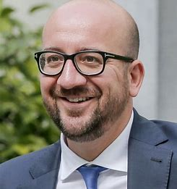
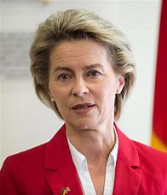
European Union
New president of Council
Charles Michel
New President of Commission
Ursula von der Leyen
New European Parliament (751)
EPP 183
S&D 154
RE 108
Greens/ EFA 74
ID 73
ECR 62
GUE/ NGL 41
NI 57

Slide 9
European Union
Directive Copyright in the DSM
Definitions “OSSCP” (excl start ups)
Digital and cross-border teaching activities, Art 5
Extended Collective management, Art 13
Claims to fair compensation, Art 16
Use of protected content by online content-sharing service providers, Art 17 (formerly 13)
Fair remuneration in exploitation contracts of authors and performers, Art 18-23
Directive Online (Re-) transmissions
Regulation on geo-blocking
EU Plans for a Digital Services Act

Slide 10
Court of Justice European Union
Case C 476/ 17 (“Kraftwerk v Pelham”)
Reproduction:
Quotation exception
Free use exception Germany
Case C 469/17 (“Funke Medien”)
Subsistence of Copyright
Exceptions
Case C 516/17 (“Spiegel”)
Exceptions (general and quotation)

Slide 11
International law reforms
Canada
South Africa
Ireland
WIPO

